Slide 1

Case Study: Intelligent Systems (WS25/26)
Predictive Maintenance of Milling Machines
Lecturer: Hamidreza Heidari
Members: Irtaza Janjua, Soman Tariq, Sadeed Ahmad, Usama Ali

Slide 2
Project Overview
Industrial Problem
Milling machines are critical production assets
Unexpected machine failures lead to unplanned downtime, production delays, and high maintenance costs
Traditional preventive maintenance often replaces components too early or too late
Main Goal
Use machine sensor data (e.g. temperature, torque, vibration) to Detect early signs of machine degradation
Predict failures before breakdown occurs, enabling planned maintenance

Slide 3
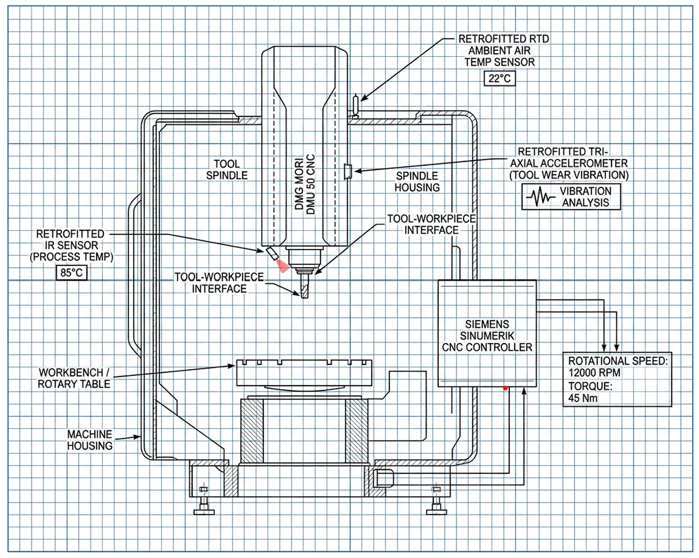
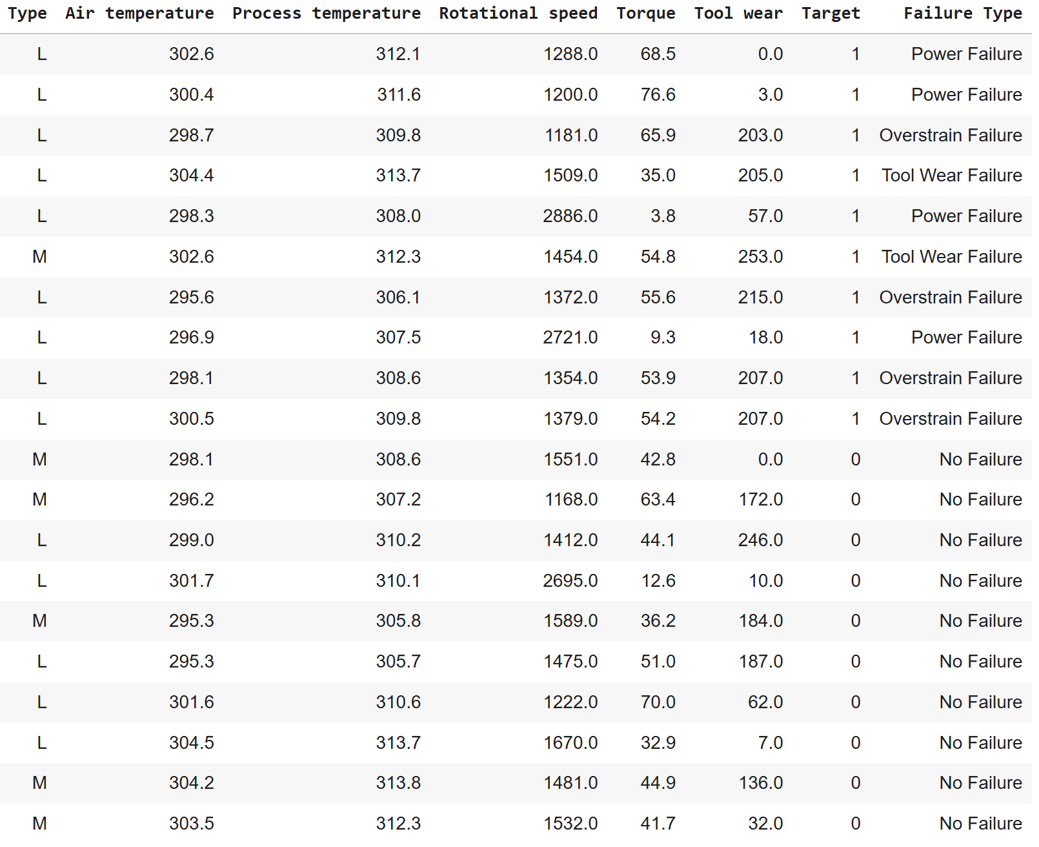
DMU 50

Slide 4
Data Understanding
Data Source
Industrial milling machine operating data
10,000 machine operating cycles
Three machine quality levels:
Low (50%), Medium (30%), High (20%)
Monitored Machine Signals
Air temperature [K]
Process temperature [K]
Spindle speed (rpm)
Torque (Nm)
Tool wear (min)
Maintenance Targets
Machine failure: Yes / No

Slide 5
Data Exploration

Slide 6





Methodology flowchart
Preprocessing
Data cleaning and missing value correction
Handling class imbalance using SMOTE (Synthetic Minority Oversampling Technique)
Implementation of PCA (Principal Component Analysis) for Feature Engineering
Tools:
Modeling
Train Random Forest classifier
Train Deep Learning Model
Sensor data used as input to predict failures
Validation
Evaluate model performance using Accuracy, Precision, Recall, F1-score
Confusion matrix shows which failures are predicted well
Deployment
Predictions displayed on a Streamlit dashboard
User-friendly and easy to monitor
18.01.2026
6

Slide 7
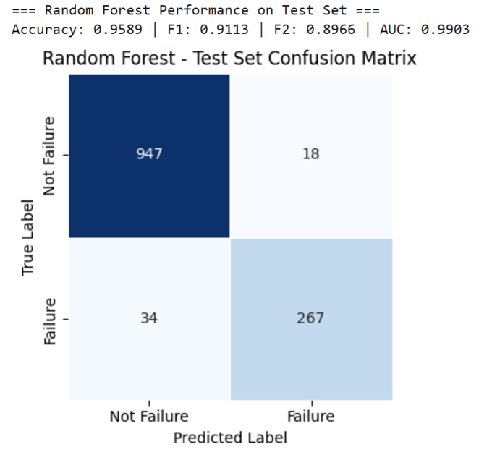
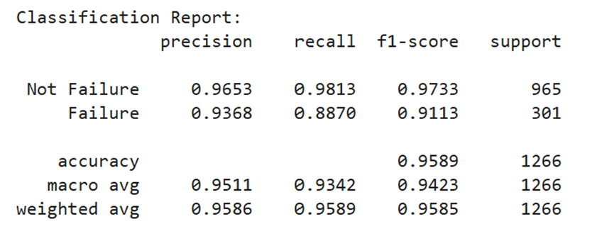
Results: Random Forest
Selected Random Forest as the baseline due to strong performance in PdM literature.

Slide 8
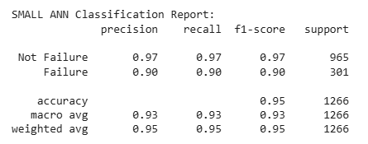
Results: Basic ANN Architecture
2 hidden layers: 128 → 64 neurons
ReLU activations + Dropout(0.3)
Softmax output layer
Trained with Adam + EarlyStopping

Slide 9
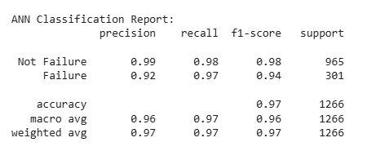
Results: Advanced ANN Architecture
ANN Architecture: 5 hidden layers with 512 → 256 → 128 → 64 → 32 neurons, followed by a softmax output layer.
Stacked dense layers with:
ReLU activation → prevents vanishing gradients, fast and stable training.
Batch Normalization → stabilizes distributions across layers, speeds convergence.
Dropout → reduces co-adaptation, improves generalization.
L2 weight regularization → penalizes overly large weights, controls model complexity.

Slide 10
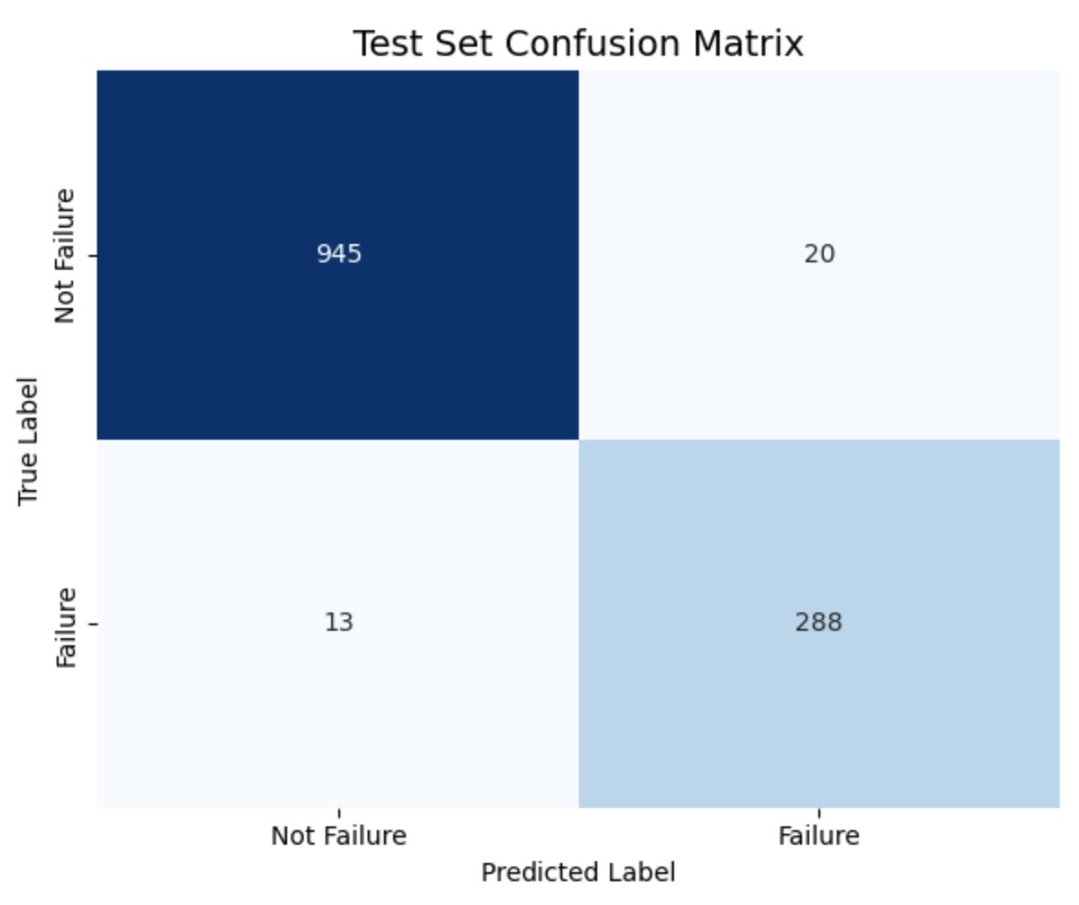
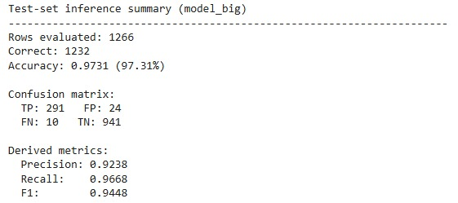
Results: Validation
Validation Approach
Model inference evaluated on held-out test dataset
Predictions compared with actual machine failure labels to verify performance
Why Validation is Reliable
Test data not seen during training, ensuring unbiased assessment
Performance metrics (accuracy, recall) demonstrate the model effectively detects failures

Slide 11
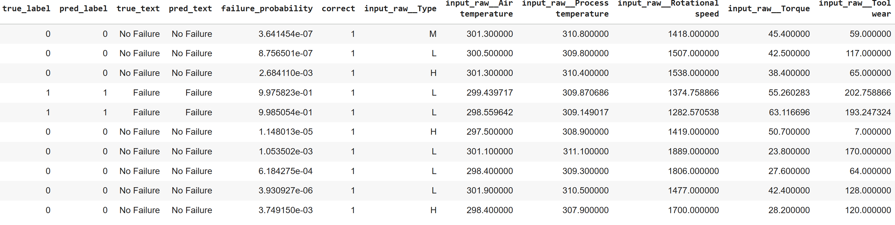
Results: Validation

Slide 12
Discussion and Analysis of Results
Precision: Avoiding False Alarms
Definition: Out of all predictions where we say "failure will occur", how many are actually correct?
In Our Context: Precision measures unnecessary maintenance interventions. A high precision prevents wasting money on false alarms.
Recall: Catching All Failures
Definition: Out of all actual failures, how many do we successfully predict?
In Our Context: Recall is critical for PdM, a single missed failure causes unplanned downtime, wasting materials, and safety risks. Missing 3% of failures is far better than missing 12%.

Slide 13
Discussion and Analysis of Results
Model | Precision | Recall | Improvement
Random Forest (Baseline) | 93.7% | 88.7% | —
Initial ANN | 90.0% | 90.0% | -3.7% / +1.3%
Advanced ANN ⭐ | 92.0% | 97.0% | -1.7% / +8.3%
+8.3%
-1.7%
97.0%
Recall Gain
Precision Gain
Final Recall
Fewer missed failures
Fewer false alarms
Only 3% missed
Key Finding: The Advanced ANN achieved 97.0% recall, meaning we detect 97 out of 100 actual failures. With 5 hidden layers, Batch Normalization, and combined Dropout + L2 regularization, the model captures complex fault signatures that simpler models miss.

Slide 14
Summary
Implemented a data preprocessing and visualization pipeline to generate insights.
Trained and validated ANN-based predictive maintenance model
Inference pipeline implemented (preprocessing + prediction)
Interactive Streamlit app for real-time failure prediction from sensor inputs
Created a reference predictive maintenance framework that can be adapted to different milling machines by mapping corresponding sensor inputs.

Slide 15
Future Scope
Add accelerometer to capture tool vibration signatures → detect mechanical degradation earlier, enabling recall improvement and production downtime prevention.
Deploy drift detection system to monitor model accuracy in production → trigger automatic retraining when recall drops below a certain threshold.
Use the pre-trained Advanced ANN architecture as foundation for different machines → fine-tune only final output layers on new machine data

Slide 16
References
[1] Carvalho et al., 2019 Systematic Review of ML in PdM
[2] Matzka, 2020 Explainable AI for PdM
[3] Sujata Butte, Prashanth A. R., and Sainath Patil, 2018 — Machine learning based predictive maintenance strategy: a super learning approach with deep neural networks. IEEE, 2018

